Slide 1

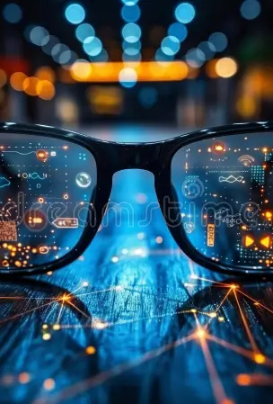


Team Innovions
RAYAURA
From Your Eyes, For Your World
Team Innovions:
1.Chanchal Chavhan(Leader)
2. Shraddha Chavan
3. Sanika More
4.Kunal Gawand
5.Swarup Sandhan

Slide 2
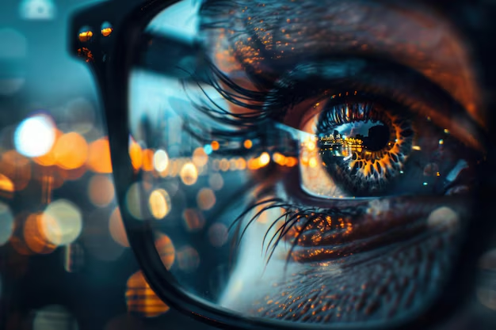
Rayaura - Your Aura is Limitless
Overview
1️⃣ Introduction & Problem Statement
2️⃣ Technology Overview
3️⃣ Comparative Analysis
4️⃣ System Architecture
6️⃣ Market Potential & Data Insights
7️⃣ Future Prospects & Enhancements
8️⃣ Conclusion & Call to Action

Slide 3




Introduction & Problem Statement
Millions of visually impaired individuals struggle with navigation and obstacle detection. Existing solutions like white canes, guide dogs, and expensive smart glasses have limitations. Rayaura, an AI-powered smart spectacle, offers a cost-effective, real-time assistive solution with AI, IoT, and voice assistance for enhanced mobility and independence.

Slide 4

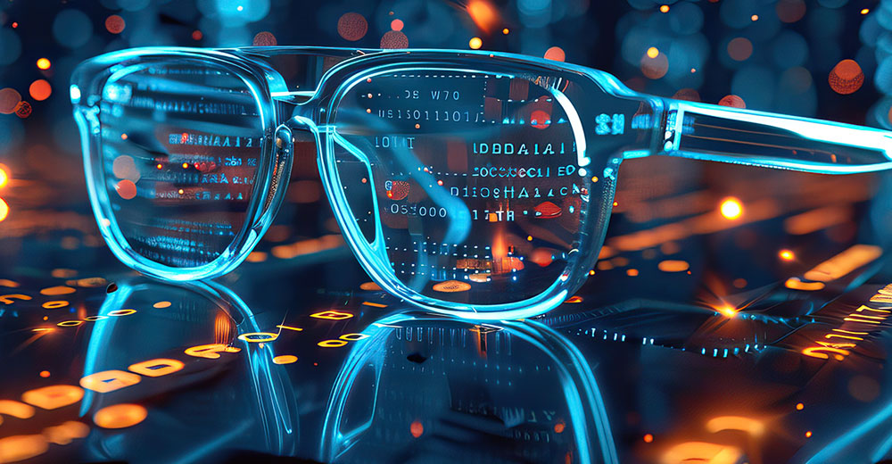

Technology Overview
Core Technologies Used in Rayaura
Ultrasonic Sensor, AI-Powered Camera , Edge AI Processing ,Real-Time Voice Assistance , IoT Connectivity ,Dual Mode Functionality –
Navigation Mode for visually impaired users.
Driving Assistance Mode for real-time distance alerts.)
Why Rayaura?
✔ Faster & smarter object detection.
✔ Cost-effective compared to existing high-end solutions.
✔ Enhances independence and mobility.

Slide 5






How Rayaura Works?
Obstacle Detection:
01
Ultrasonic sensors detect nearby objects.
Measures distance and alerts the system.
AI-Based Object Recognition:
02
Identifies objects, road signs, or pedestrians.
Voice Assistance & Feedback
03
AI converts detected objects into voice output.
User receives real-time alerts via the speaker module.
Modes of Operation:
🔹 Navigation Mode (for visually impaired)
🔹 Driving Mode (for road safety)
IoT Connectivity & App Integration:
04
User can customize settings via mobile app.
Data syncs for enhanced user experience.

Slide 6
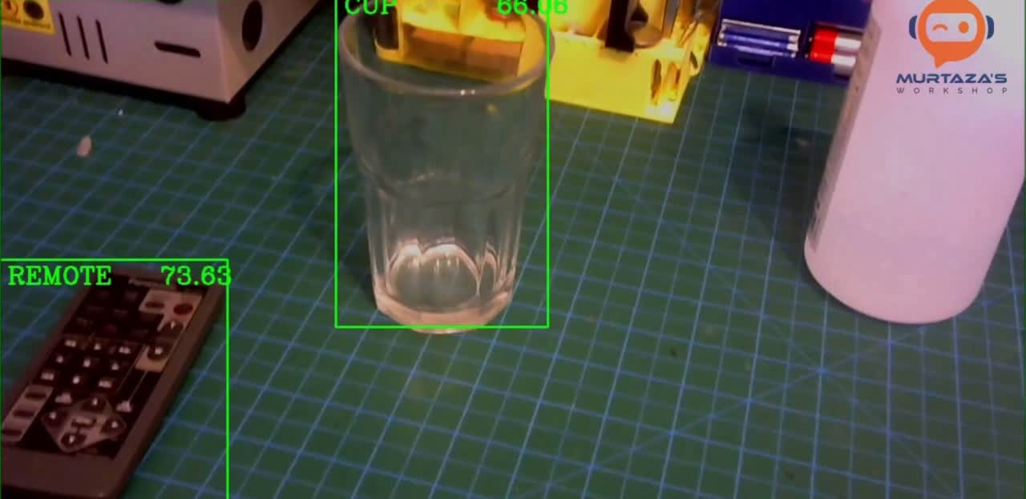
(For Obstacle Detection and R eal time Monitoring )
Working Video

Slide 7
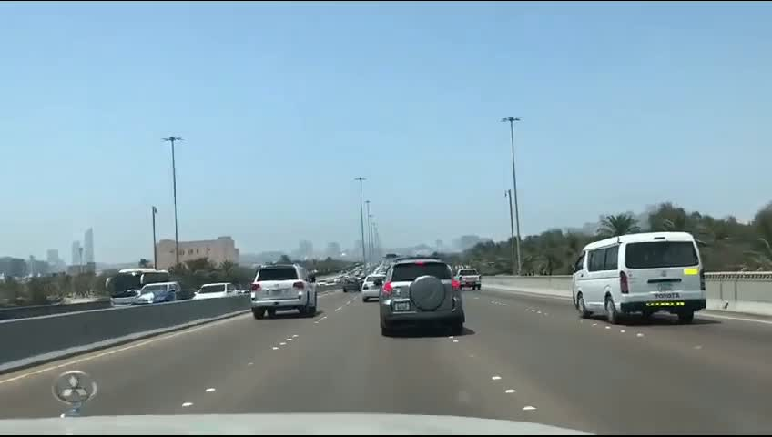
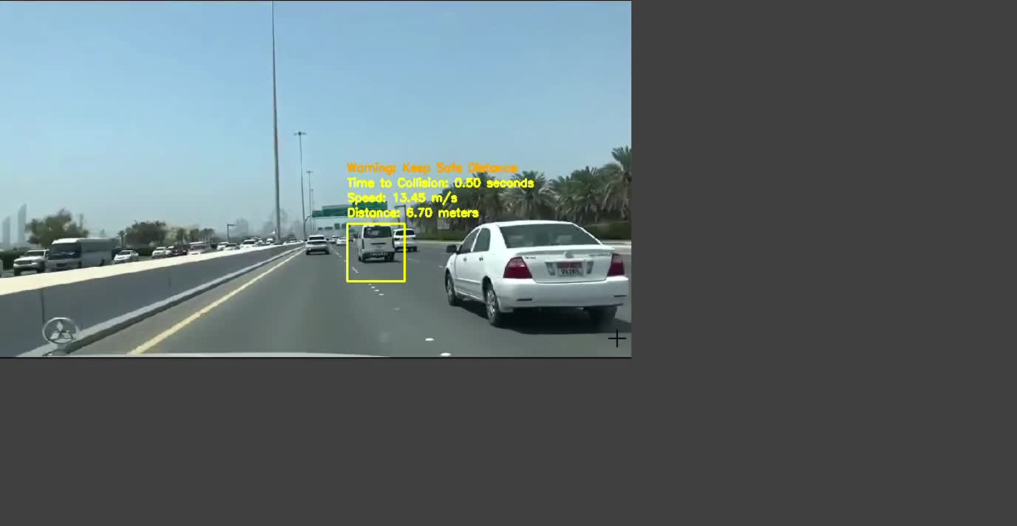
Raw Input
System Output

Slide 8


Conclusion
Rayaura empowers visually impaired individuals and drivers with AI-driven smart assistance.
🔹 Enhances safety, mobility, and independence through real-time obstacle detection and voice feedback.
🔹 Combines affordability, innovation, and accessibility for a smarter future.
🔹 Bridging the gap between vision and perception with intelligent technology.
🚀 Rayaura – Seeing Beyond Limits!

Slide 9
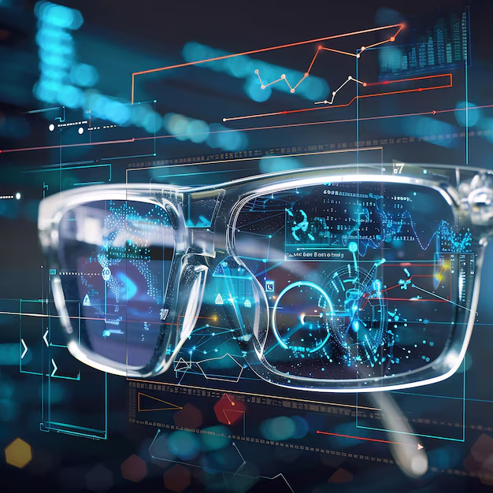




THANK YOU!!
Team Innovions
Chanchal Karna Chavhan
+91 8087871131
sakuchavhna08@gmail.com
🚀 Get Ready to See the World with Rayaura
Bcz Your Aura is limitless

